Slide 1

Asymmetric information
Notes on Behavioural Economics
Jason Collins

Slide 2
The market for lemons
Price 𝑝 is fixed
Quality is unobservable.

Slide 3

The market for lemons
Good cars: $q$
Lemons: $1−q$

Slide 4
Seller
Good cars: $10,000
Lemons: $5,000
Buyer:
Good cars: $15,000
Lemons: $7,500

Slide 5
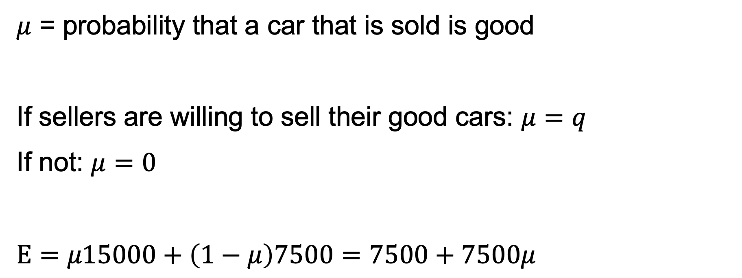
$μ$ = probability that a car that is sold is good
If sellers are willing to sell their good cars: $μ=q$
If not: $μ=0$
$$E=μ15000+\left(1−μ\right)7500=7500+7500μ$$

Slide 6
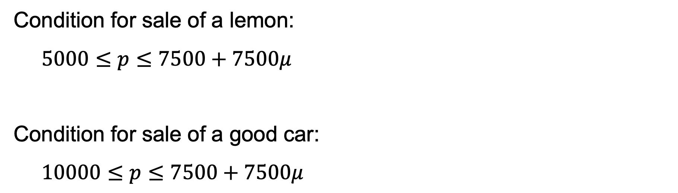
Condition for sale of a lemon:
$$5000≤p≤7500+7500μ$$
Condition for sale of a good car:
$$10000≤p≤7500+7500μ$$

Slide 7
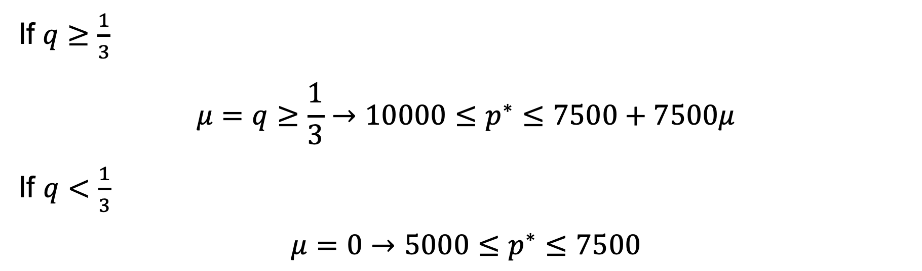
If $q≥\frac{1}{3}$
$$μ=q≥\frac{1}{3}→10000≤p^{∗}≤7500+7500μ$$
If $q<\frac{1}{3}$
$$μ=0→5000≤p^{∗}≤7500$$

Slide 8


Slide 9
The winner’s curse

Slide 10
Common value auctions

Slide 11


Slide 12
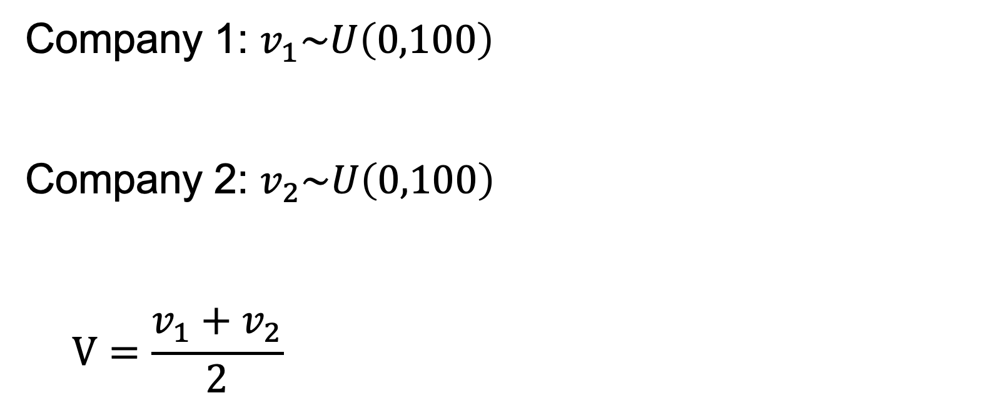
Company 1: $v_{1}\sim U\left(0,100\right)$
Company 2: $v_{2}\sim U\left(0,100\right)$
$$V=\frac{v_{1}+v_{2}}{2}$$

Slide 13

Company 1: $v_{1}=\$50$
Company 2: $v_{2}$

Slide 14
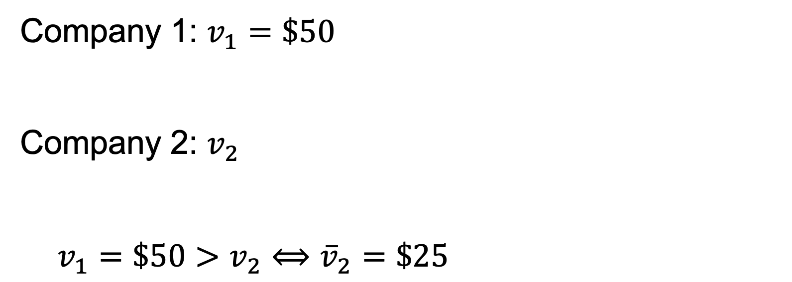
Company 1: $v_{1}=\$50$
Company 2: $v_{2}$
$$v_{1}=\$50>v_{2}⟺{\overline{v}}_{2}=\$25$$

Slide 15
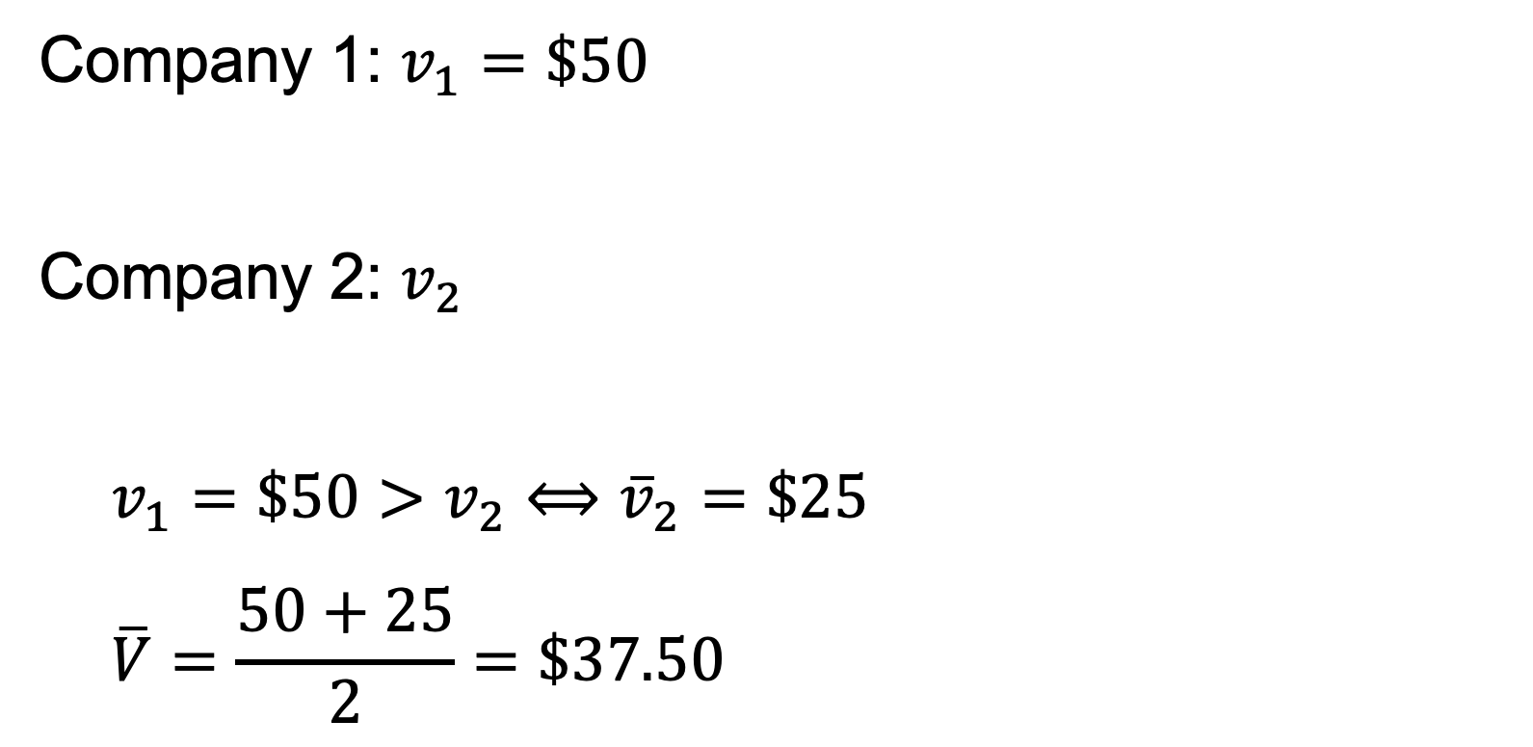
Company 1: $v_{1}=\$50$
Company 2: $v_{2}$
$$v_{1}=\$50>v_{2}⟺{\overline{v}}_{2}=\$25$$
$$\overline{V}=\frac{50+25}{2}=\$37.50$$

Slide 16
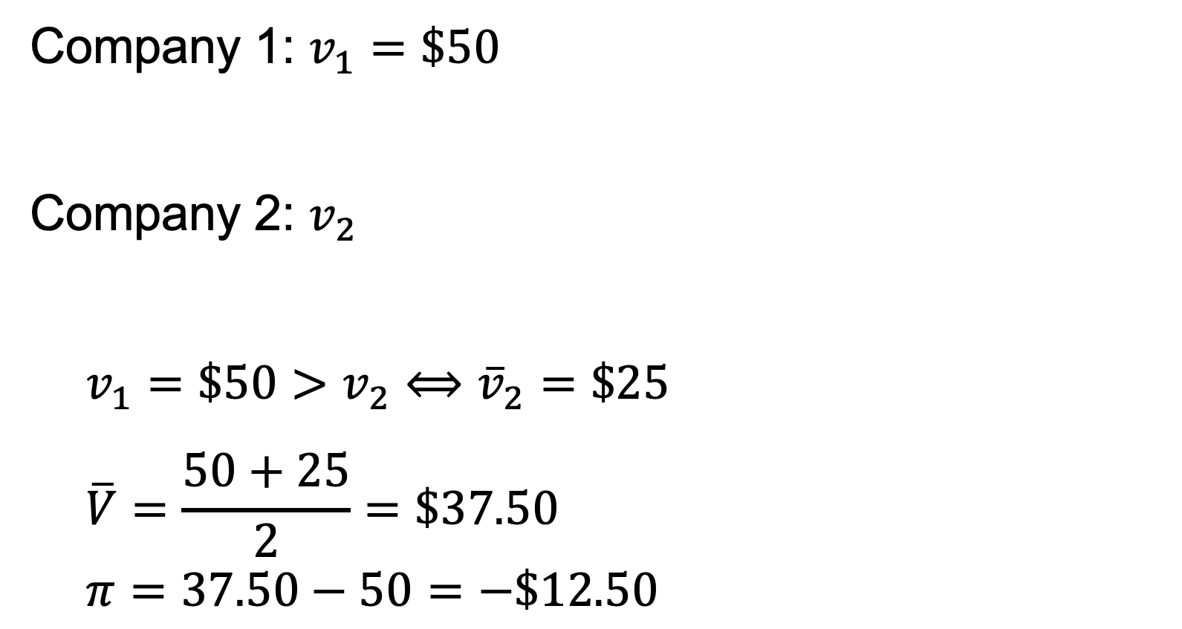
Company 1: $v_{1}=\$50$
Company 2: $v_{2}$
$$v_{1}=\$50>v_{2}⟺{\overline{v}}_{2}=\$25$$
$$\overline{V}=\frac{50+25}{2}=\$37.50$$
$$π=37.50−50=−\$12.50$$

Slide 17

Company 1: $v_{1}=\$50$, bid=$37.50
Company 2: $v_{2}$

Slide 18
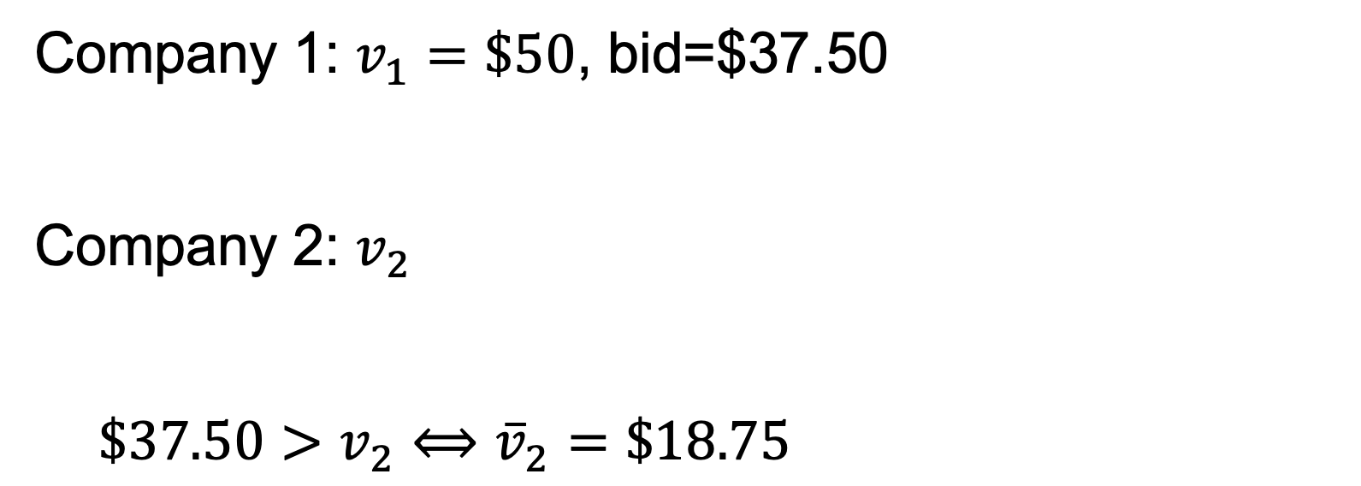
Company 1: $v_{1}=\$50$, bid=$37.50
Company 2: $v_{2}$
$$\$37.50>v_{2}⟺{\overline{v}}_{2}=\$18.75$$

Slide 19
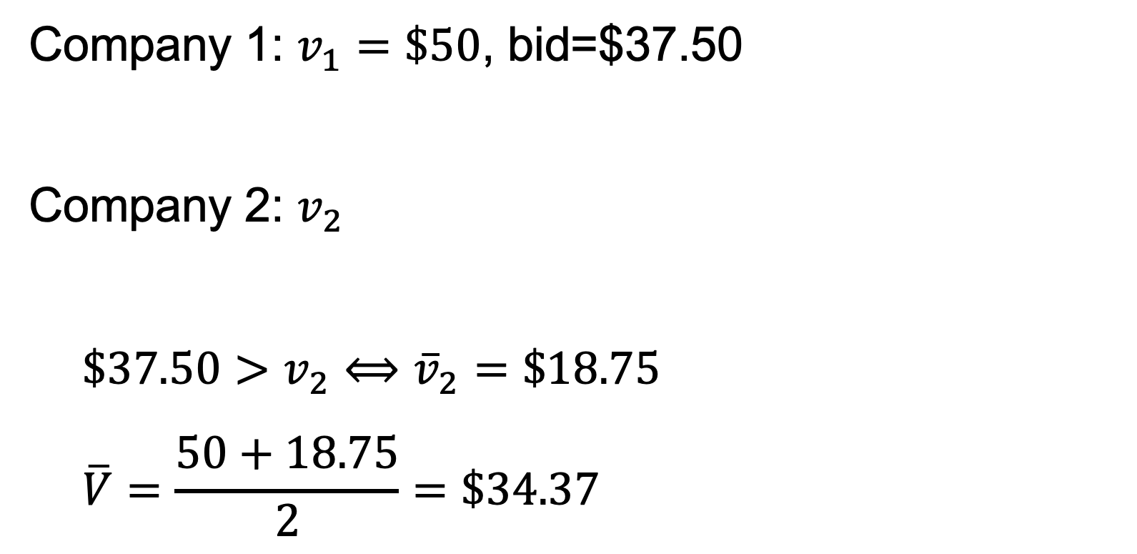
Company 1: $v_{1}=\$50$, bid=$37.50
Company 2: $v_{2}$
$$\$37.50>v_{2}⟺{\overline{v}}_{2}=\$18.75$$
$$\overline{V}=\frac{50+18.75}{2}=\$34.37$$

Slide 20
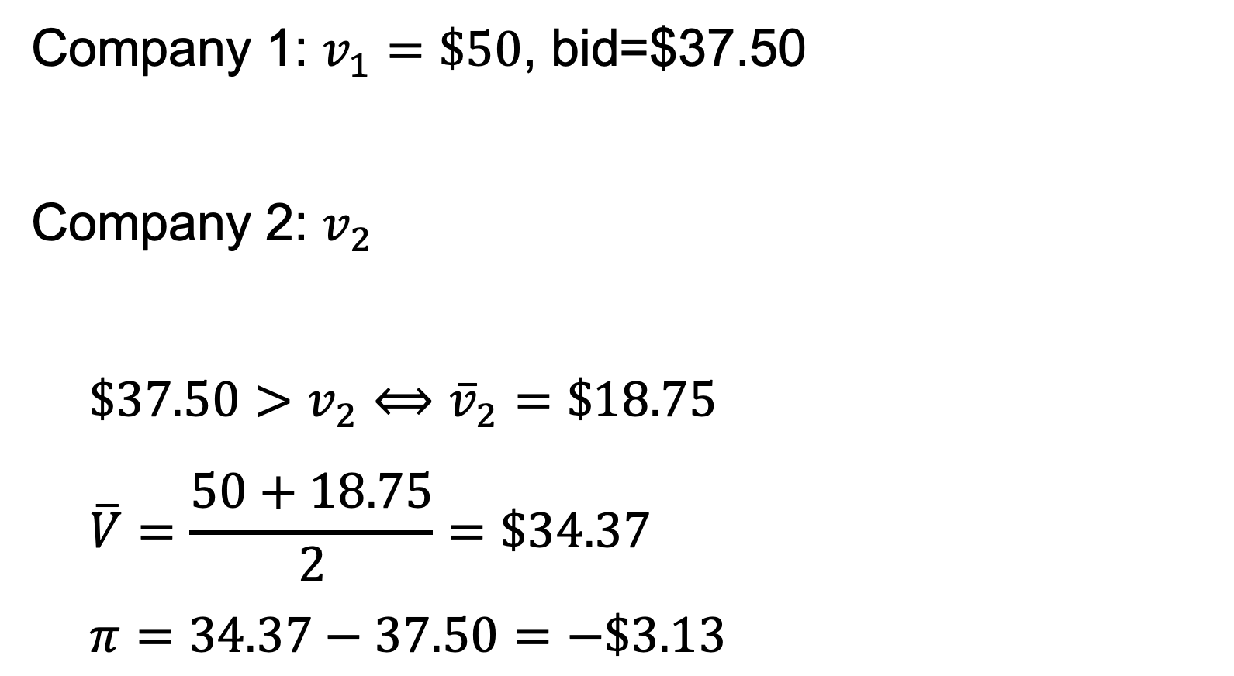
Company 1: $v_{1}=\$50$, bid=$37.50
Company 2: $v_{2}$
$$\$37.50>v_{2}⟺{\overline{v}}_{2}=\$18.75$$
$$\overline{V}=\frac{50+18.75}{2}=\$34.37$$
$$π=34.37−37.50=−\$3.13$$

Slide 21

Company 1: $v_{1}=\$50$, bid=$25
Company 2: $v_{2}$

Slide 22
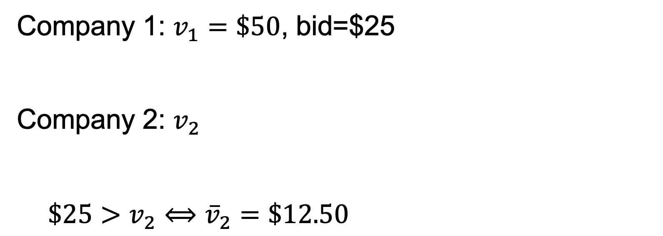
Company 1: $v_{1}=\$50$, bid=$25
Company 2: $v_{2}$
$$\$25>v_{2}⟺{\overline{v}}_{2}=\$12.50$$

Slide 23
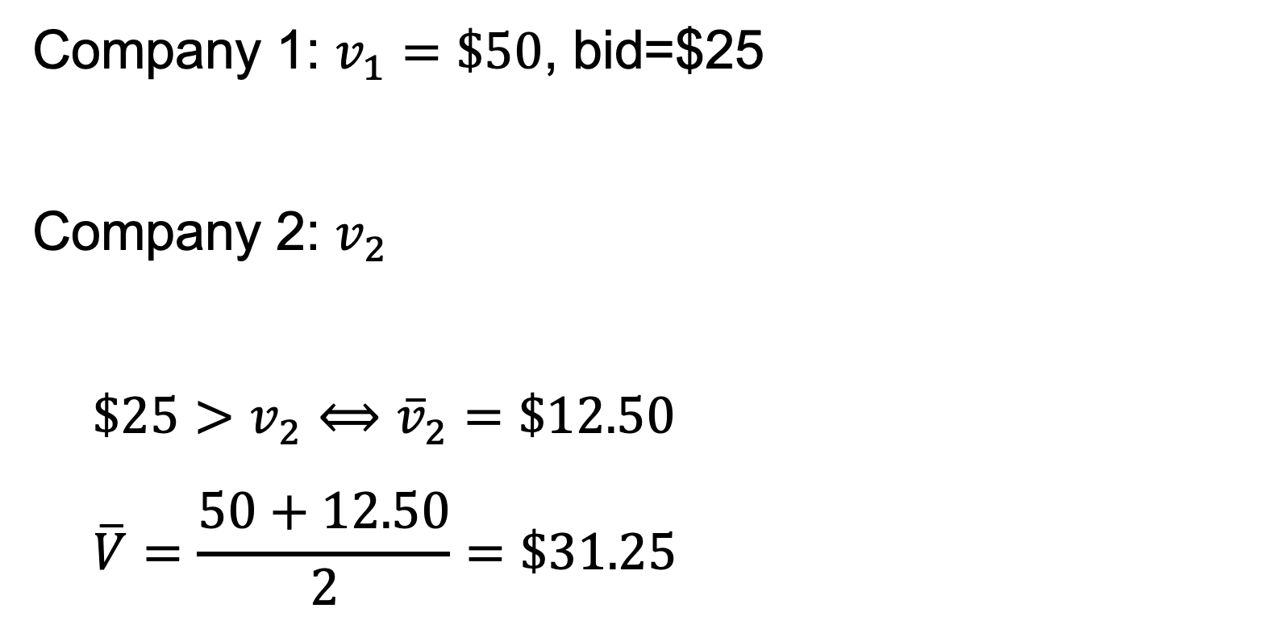
Company 1: $v_{1}=\$50$, bid=$25
Company 2: $v_{2}$
$$\$25>v_{2}⟺{\overline{v}}_{2}=\$12.50$$
$$\overline{V}=\frac{50+12.50}{2}=\$31.25$$

Slide 24
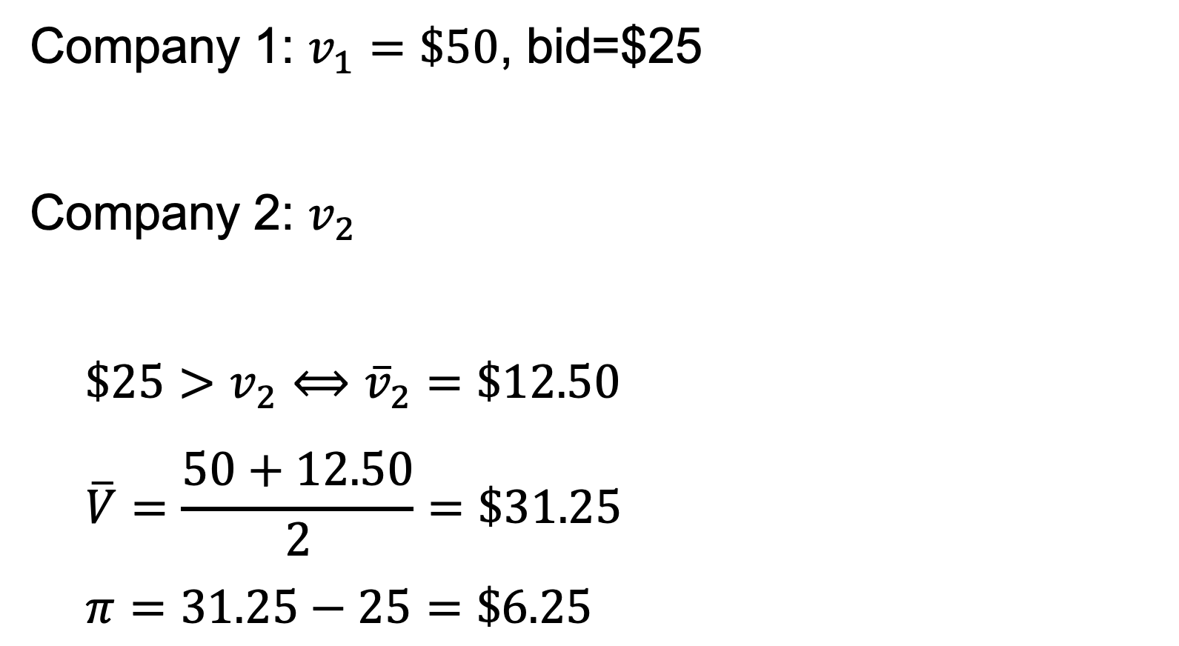
Company 1: $v_{1}=\$50$, bid=$25
Company 2: $v_{2}$
$$\$25>v_{2}⟺{\overline{v}}_{2}=\$12.50$$
$$\overline{V}=\frac{50+12.50}{2}=\$31.25$$
$$π=31.25−25=\$6.25$$

Slide 25

Company 1: $v_{1}$, bid $=δv_{1}$
Company 2: $v_{2}$

Slide 26
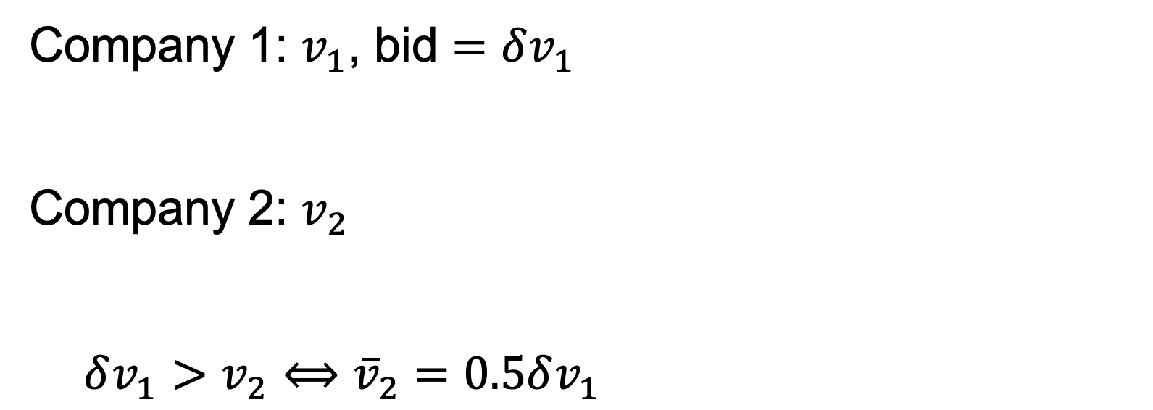
Company 1: $v_{1}$, bid $=δv_{1}$
Company 2: $v_{2}$
$$δv_{1}>v_{2}⟺{\overline{v}}_{2}=0.5δv_{1}$$

Slide 27
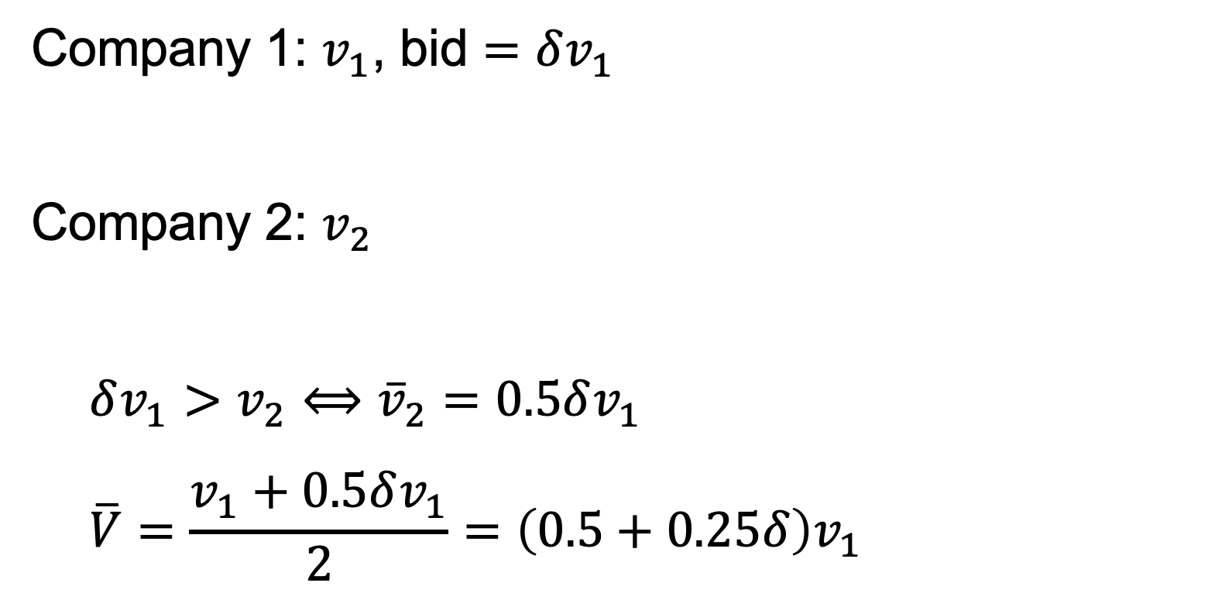
Company 1: $v_{1}$, bid $=δv_{1}$
Company 2: $v_{2}$
$$δv_{1}>v_{2}⟺{\overline{v}}_{2}=0.5δv_{1}$$
$$\overline{V}=\frac{v_{1}+0.5δv_{1}}{2}=\left(0.5+0.25δ\right)v_{1}$$

Slide 28
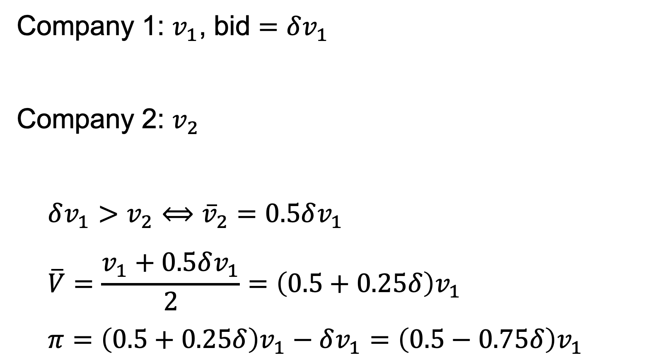
Company 1: $v_{1}$, bid $=δv_{1}$
Company 2: $v_{2}$
$$δv_{1}>v_{2}⟺{\overline{v}}_{2}=0.5δv_{1}$$
$$\overline{V}=\frac{v_{1}+0.5δv_{1}}{2}=\left(0.5+0.25δ\right)v_{1}$$
$$π=\left(0.5+0.25δ\right)v_{1}−δv_{1}=\left(0.5−0.75δ\right)v_{1}$$

Slide 29

Company 1: $v_{1}$, bid $=δv_{1}$
Company 2: $v_{2}$ , bid $=δv_{2}$

Slide 30
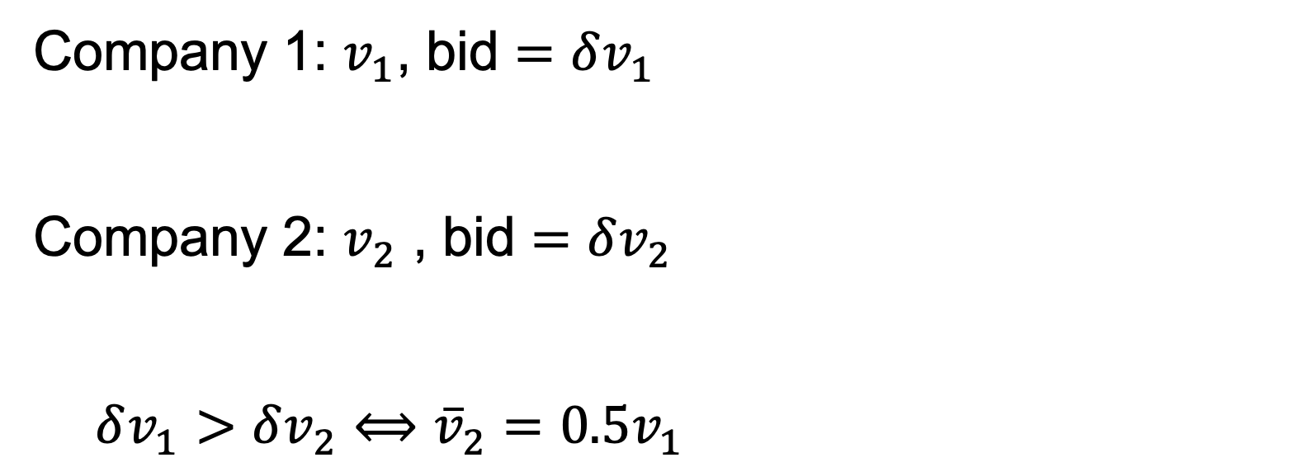
Company 1: $v_{1}$, bid $=δv_{1}$
Company 2: $v_{2}$ , bid $=δv_{2}$
$$δv_{1}>δv_{2}⟺{\overline{v}}_{2}=0.5v_{1}$$

Slide 31
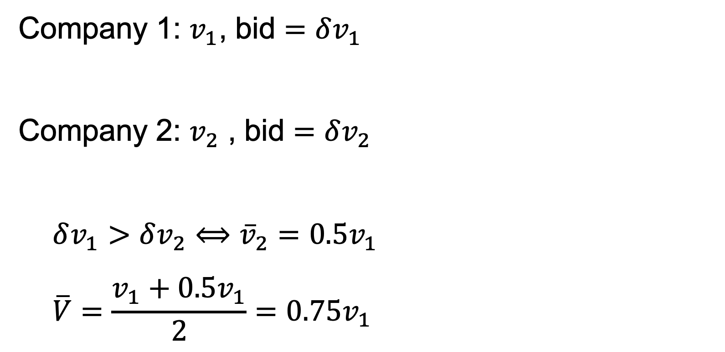
Company 1: $v_{1}$, bid $=δv_{1}$
Company 2: $v_{2}$ , bid $=δv_{2}$
$$δv_{1}>δv_{2}⟺{\overline{v}}_{2}=0.5v_{1}$$
$$\overline{V}=\frac{v_{1}+0.5v_{1}}{2}=0.75v_{1}$$

Slide 32
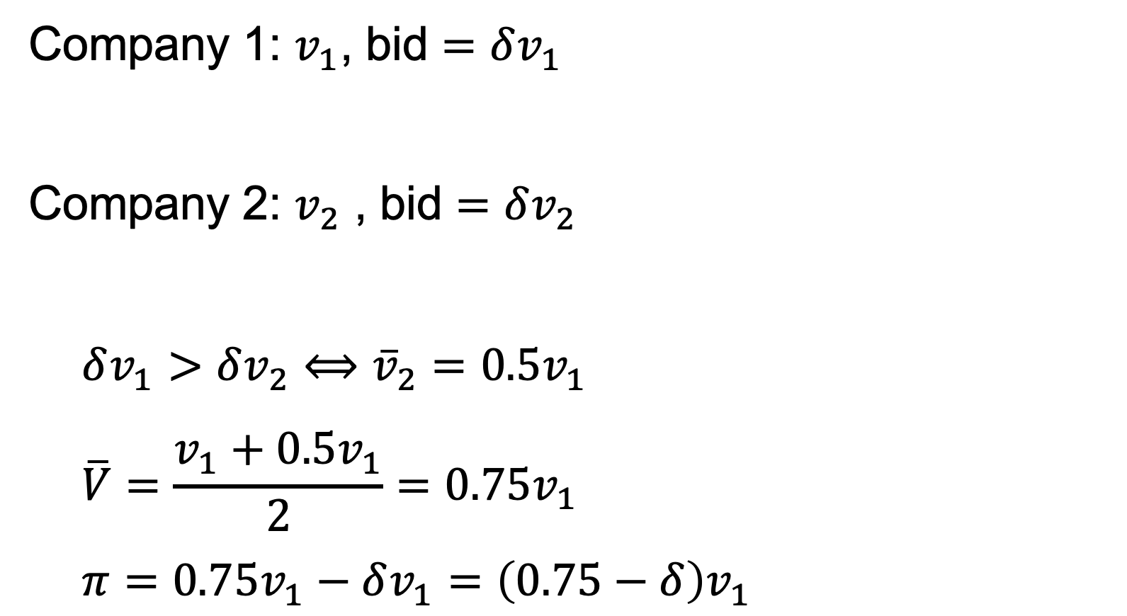
Company 1: $v_{1}$, bid $=δv_{1}$
Company 2: $v_{2}$ , bid $=δv_{2}$
$$δv_{1}>δv_{2}⟺{\overline{v}}_{2}=0.5v_{1}$$
$$\overline{V}=\frac{v_{1}+0.5v_{1}}{2}=0.75v_{1}$$
$$π=0.75v_{1}−δv_{1}=\left(0.75−δ\right)v_{1}$$

